Slide 1
Welcome to our meeting!
Thank you for being here.
Eastside Genealogical Society
Bellevue, Washington
eastsidegenealogicalsociety.org

Slide 2
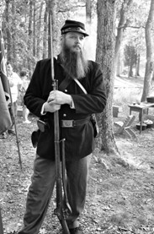
About our Next Meeting
February 13, 7:00 PM PT
Topic: That Splendid Little War: Researching the Spanish-American War
Service records, pensions and other primary sources covering veterans who served in both the regular army and volunteer forces during the Spanish-American War. Also included are the later Philippine Insurrection and the Boxer Rebellion.
Our speaker: Michael L. Strauss
Virtual doors open at 6:30 PM; the meeting will start at 7:00 PM
Check our website for more information: eastsidegenealogicalsociety.org

Slide 3
Looking ahead to future EGS meetings
Check our website for more information: eastsidegenealogicalsociety.org
March 13: The Scots-Irish in America
– Peggy Clemens Lauritzen
April 10: There’s Gold in Federal Government Reports
– Mike White

Slide 4
Can you please help EGS?
Looking for someone to take over the vital role of Treasurer to let Glen focus on his ongoing battle with cancer.
Please consider volunteering to help!
Contact Janet Stroebel at president@eastsidegenealogicalsociety.org with questions or to volunteer.

Slide 5
Tonight’s Discussion Question
Tell us in the chat about a genealogy holiday gift you received that you would recommend to others.

Slide 6
Twisted Branches
Request for newsletter articles
We’re looking for member input to share in the newsletter each month.
For February: In using DNA in your genealogical research, have you turned up some unexpected results? If so, would you please share the story with the membership through our newsletter?
Deadline: January 22
Send your story to: newsletter@eastsidegenealogicalsociety.org

Slide 7

Italian Interest Group
Date: Saturday, January 18 from 1:30 to 3:30 PM PT via Zoom
Topic: Multiple Lies and an Alias: Solving the Mystery of One Italian Immigrant
A search for any information on the biological father of an 83-year-old Italian man yields unexpected twists and turns. Leveraging a wide variety of record sets – some more obscure than others – this case study of an Italian immigrant in New York in the 1920s reveals many conflicts, scandal, and lies. It’s a case study about how documentary records, DNA, and oral tradition solves the mystery of this elusive man.
Speaker: Kerri Tannenbaum
For more information and to register: egs-iig.com
SIG News

Slide 8

SIG News
German Interest Group
Date: Friday, February 7
Time:12:30 to 2:30 PM PT via Zoom
Topic: How a Non-German Speaking Person Can Trace Their German Ancestors
Speaker: Bernard N. Meisner
Registration is required: https://tinyurl.com/mtyhjk
Visitors welcome and more information at: https://egsgermangroup.wordpress.com.

Slide 9

SIG News
Family Tree Maker SIG
Date: Friday, January 17
Time: 10:30 AM to 12:30 PM PT via Zoom
The Family Tree Maker Special Interest Group is designed for genealogists who are using, or considering using, Family Tree Maker software to house their genealogical information. Attendees are encouraged to bring challenges or questions to obtain assistance from others. In addition, there is a presentation at each meeting about some aspect(s) of the software. Everyone is welcome to attend.
To obtain the Zoom link, email ftmsig@eastsidegenealogicalsociety.org.

Slide 10
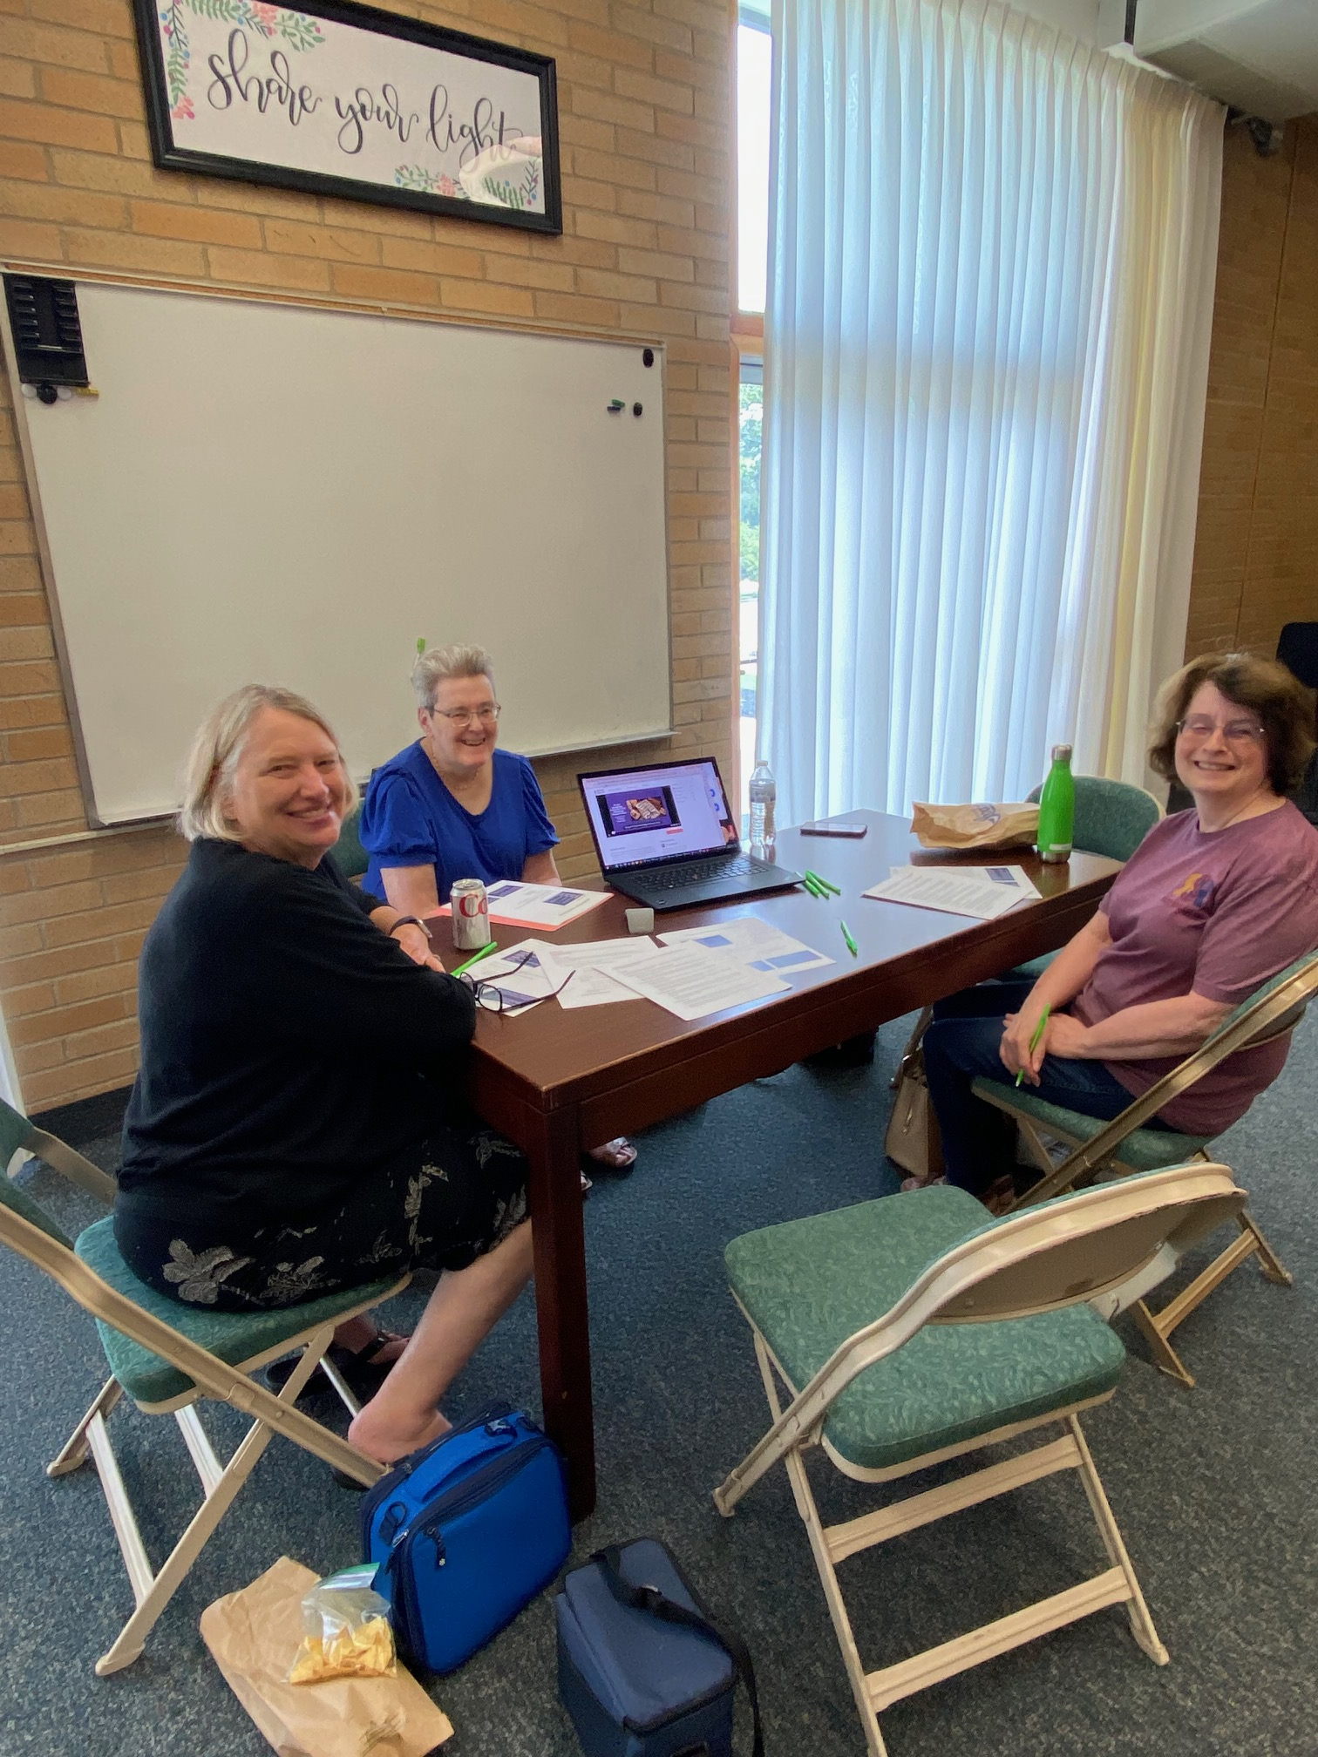
EGS Lunch Bunch and Research
Date: Thursday, January 16
Where: Bellevue FamilySearch Center,
10675 NE 20th St., Bellevue
Lunch Bunch and Research meets on the third Thursday of each month from 11:30 AM to 1:00 PM with research time in the FamilySearch Center afterwards (up to 6:00 PM). Bring your lunch. Water and restrooms are available as we meet in the church building across the parking lot from the FS Center. Share your brick walls, new finds, and search tips with each other.
Lunch Discussion Topic: Using FamilySearch Mobile App for preserving memories

Slide 11

NEW: Genealogical Fiction Book Club
A new special interest group is forming, and you can be part of the fun! The book club will be reading and discussing fictional books with a genealogical bent.
Organizational Meeting
Date: Thursday, January 23 at 10:00 AM PT via Zoom
Contact: Kimberly Nichols at vicepresident@eastsidegenealogicalsociety.org for the Zoom link and more information. Also contact her if you are interested but can’t attend.
This will be an organizational meeting to decide what books we will read, when we will meet, how often we will meet, and the structure of our book club. Please come and participate!

Slide 12
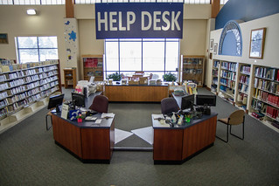
Upcoming Help Desk Opportunities
Volunteer assistance with your research
In-Person: Bellevue Library, Room 4
  2nd and 4th Thursdays of each month
  Drop in between10:30 AM and 12:30 PM
Via Zoom:
  3rd Wednesday of each month
  1:00 PM or 2:00 PM
  Sign up on KCLS.org

Slide 13

If you get value out of our meetings and/or Special Interest Groups, please consider joining ($20 for 12 months) or donating to Eastside Genealogical Society.
eastsidegenealogicalsociety.org/membership/

